Slide 1

Chatbot for IITORSP
Spring 2024 Data Science Practicum (CSP-572)

Slide 2
Team Leader
Sahil Thorat A20543914
Team Members
Albert Mandizha A20493341
Anette Volkova A20481653
Avinash Sankar A20525471
Chandana Poloju A20527866
Priyadarshini Rajendran A20476470
Ranjan Mishra A20521033 Vivian Jacob Varghese A20502106

Slide 3


Introduction
Goal/ Requirement of the Project
Create a chatbot for queries on grant applications and procedures.
Integrate Google API for authentication.
Enable document uploads for detailed queries.
Support multi-turn Q&A interactions.
Use Large Language Models (LLMs) for smarter responses.

Slide 4
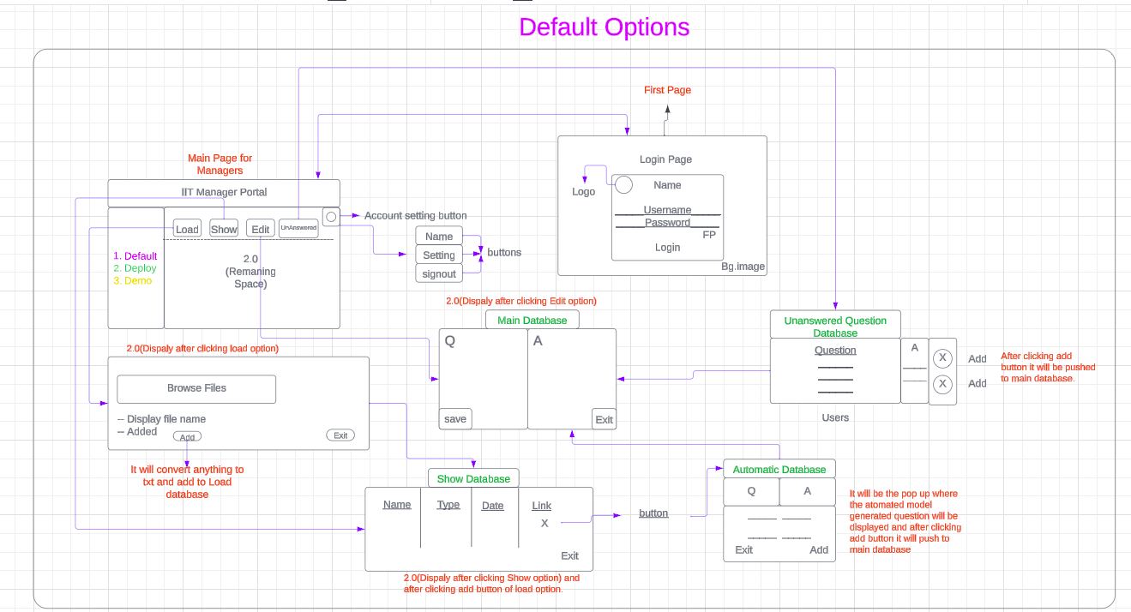
System Architecture
For Manager

Slide 5
Client/Server (CS) System:
Python-Driven Backend: Crafting the server-side with Python for robust functionality.
Simplicity in Design: Aiming for a straightforward system for user ease.
Editable Q&A Database: Facilitating real-time modifications to Q&As.
Unanswered Query Tracking: Capturing and storing unresolved inquiries for future updates.

Slide 6
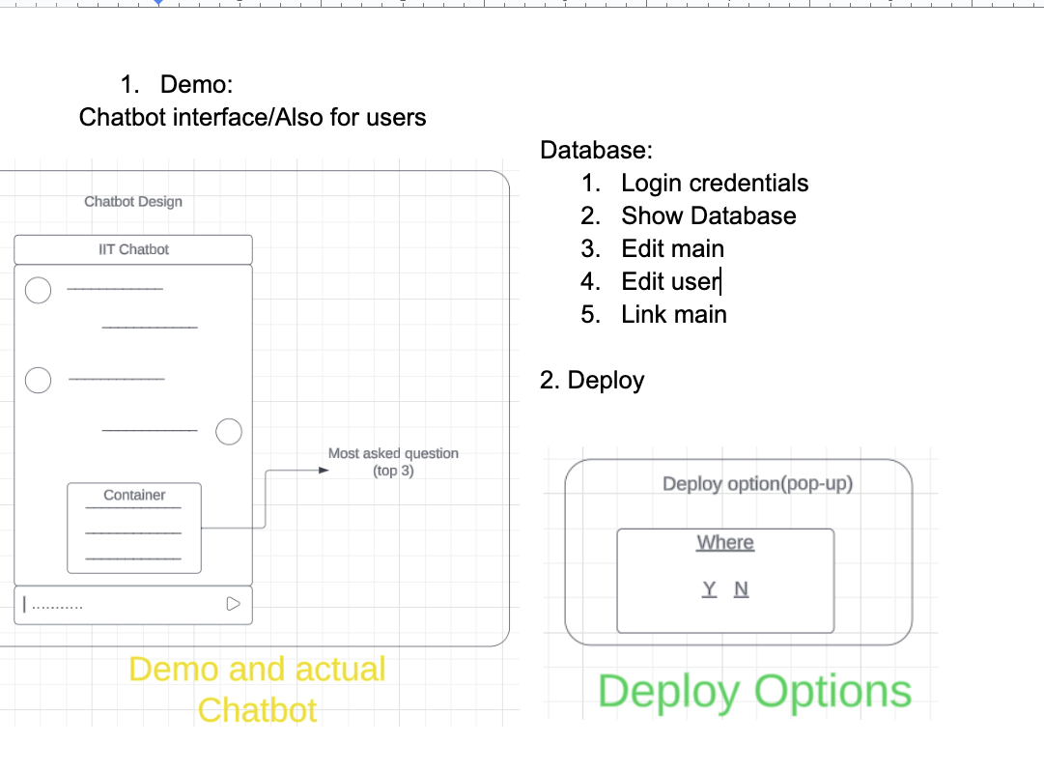
ChatBot Design:
User-Friendly Chat: Instant responses to faculty inquiries via an intuitive interface.
Highlighted FAQs: Quick access to the most common questions.
Database Integration:
Authentications: Secure login management.
Q&A Retrieval: Centralized knowledge repository.
Content Management: Editable Q&A for timely updates.
Personalization: User profile customization.
Knowledge Expansion: Connection to external data.
Content Customization: Managerial editing tools for content accuracy.
Flexible Deployment: Easy implementation across web platforms with pop-up functionality.

Slide 7

Information Retrieval (IR) for QA:
For the Information Retrieval (IR) aspect:
Streamlined IR Process: Transforming queries and database Q&As into vectors for efficient similarity analysis.
Utilization of Pre-Trained Models: Employing embedding models for effective text vectorization.
These foundational strategies are meant to guide the initial phase of the project, encouraging exploration of alternative solutions and readiness for unforeseen challenges.

Slide 8

Challenges and Team Effort:
Initial Setup: Overcame the complexity of project initialization by breaking down tasks and focusing on individual components before integration.
API Integration (Sprint 2): Resolved challenges connecting to Google API for authentication and data services.
Multi-Turn QA Management (Sprint 2): Developed a method to efficiently store and retrieve multi-turn QA interactions.
Model Selection (Sprint 5): Identified a suitable LLM for achieving high-quality vector similarity outcomes.

